Slide 1

Customer Shopping Analysis
Analyzing customer shopping to increase sales
Done by : Sukesh Pavan Bitragunta
Submitted to : Chaojie Wang

Slide 2
Introduction
Customer shopping analysis enables a company to change its product based on its target customers from various customer categories.
Instead of paying money to promote a new product to every client in the firm's database.
Company may determine which customer group is most likely to purchase the product and then market the product just to that segment.

Slide 3

Objective & Data
To understand the shopping analysis of the consumer and segregate them into groups.
This grouping will help us to promote the products that will make more sales and promote the company.
The dataset was taken from Kaggle, and the entries are from 2014, It has 2240 rows and 29 columns

Slide 4
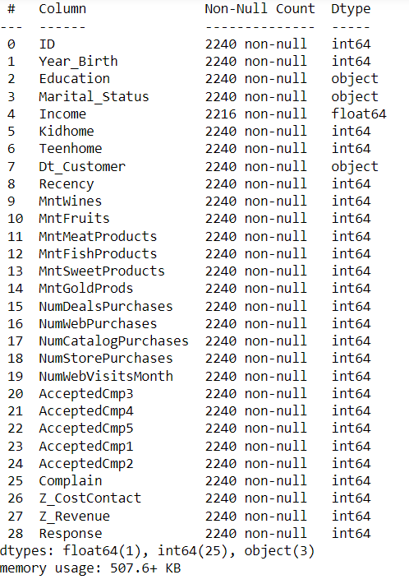
Data Pre-processing
In The dataset there are 29 columns such as customer_id , dt_customer, Income, Martial_status and other.
Removed null values and outliers from the dataset using boxplot and added new attributes to column
Such as total amount spent, number of campaigns accepted by customers and other.

Slide 5
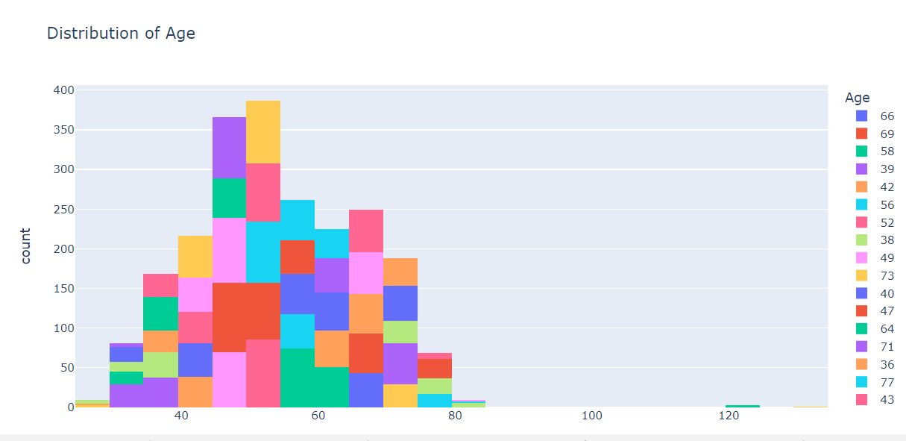
EDA(Exploratory Data Analysis)
Some of the Insights that I observed while preforming EDA

Slide 6
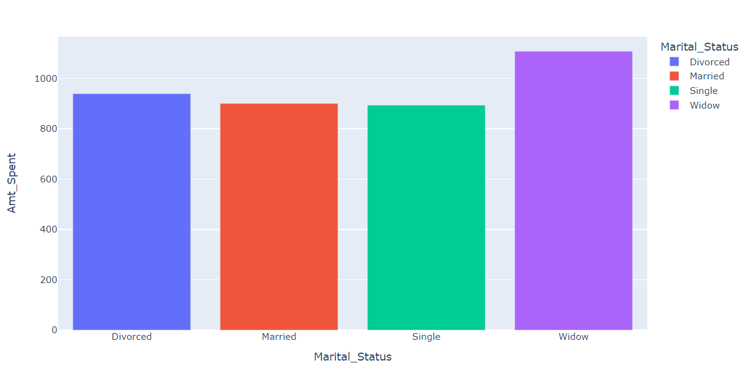
Here we can observe the amount spent by the different martial status

Slide 7
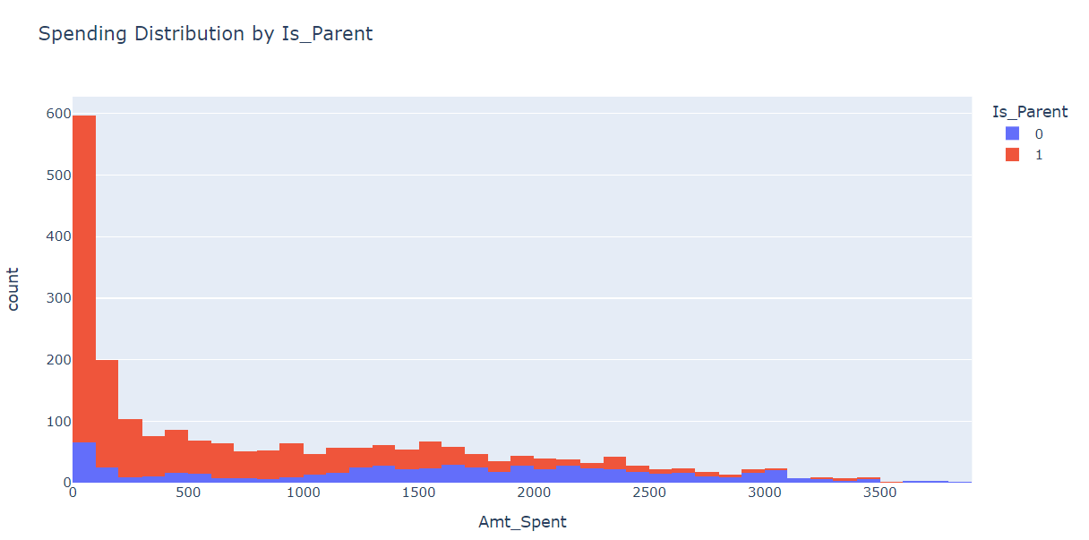
In this graph we can see how much does a parent purchase and non parent spend.

Slide 8
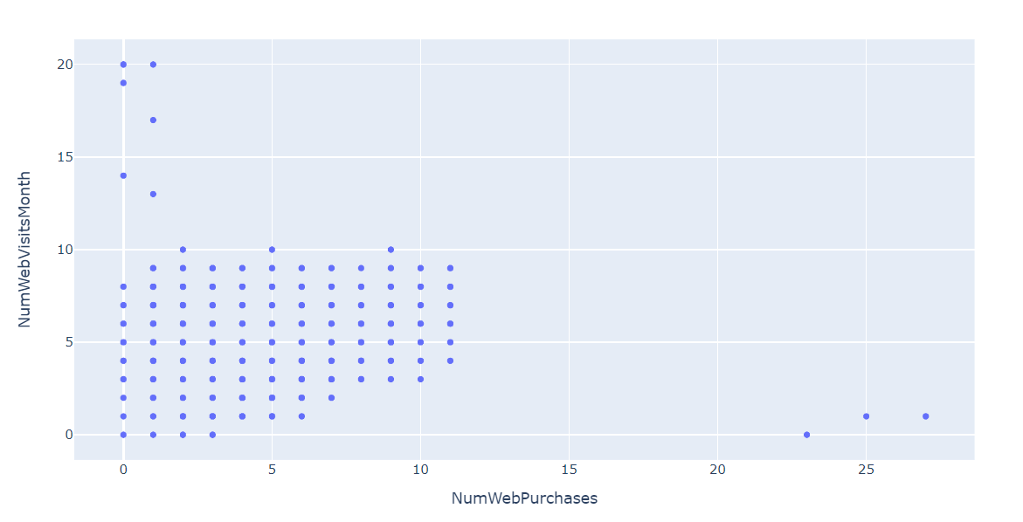
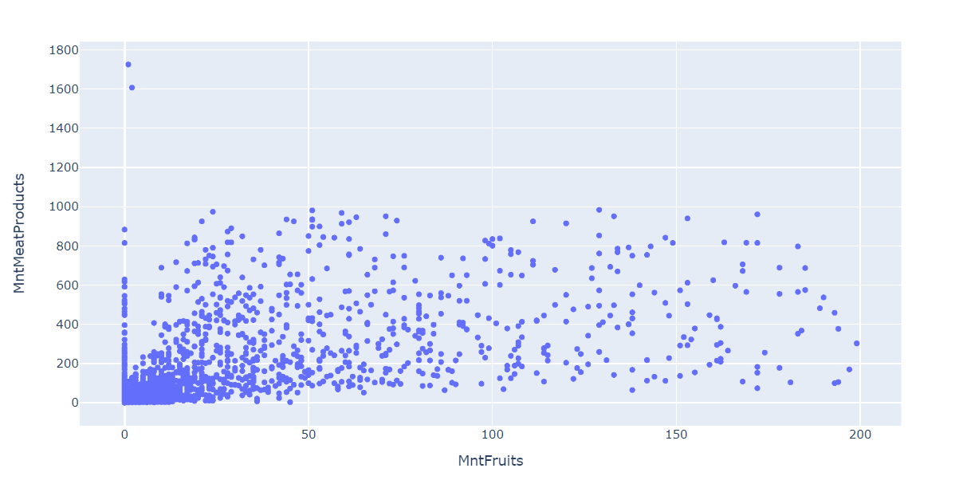

Slide 9
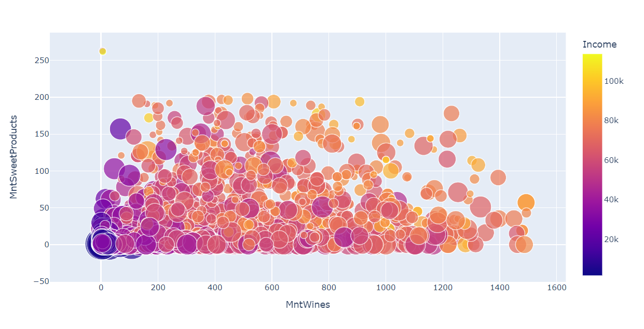

Slide 10
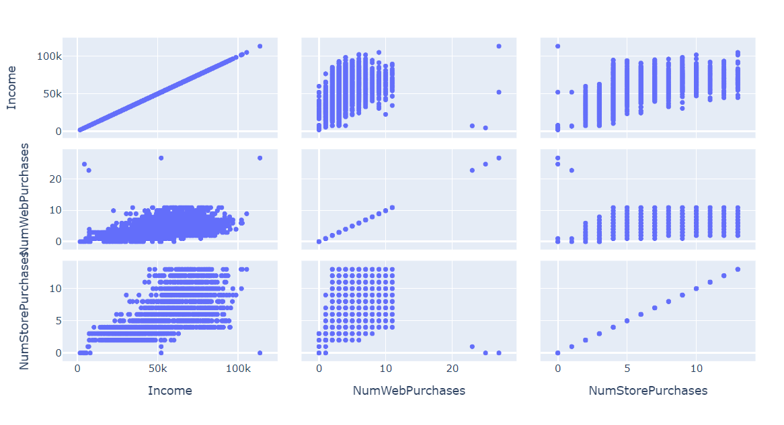

Slide 11
Machine learning
K means clustering is used to segregate the dataset. To perform the model every attribute should be a continuous variable.
One hot encoding was used to convert the categorical variables to format that can be helpful to machine learning algorithms.
Standardization of a dataset is a common requirement for many machine learning estimators: they might behave badly if the individual features do not more or less look like standard normally distributed data

Slide 12
The next step would be determining the value of k, There are two methods two perform this,
The silhouette score and plot are used to evaluate the quality of a clustering solution produced by the k-means algorithm. The highest and closest point to one is considered the optimal number of clusters.
The other one is elbow method, In the Elbow method, we are actually varying the number of clusters (K) from 1 – 10. For each value of K, we are calculating Within-Cluster Sum of Square.

Slide 13
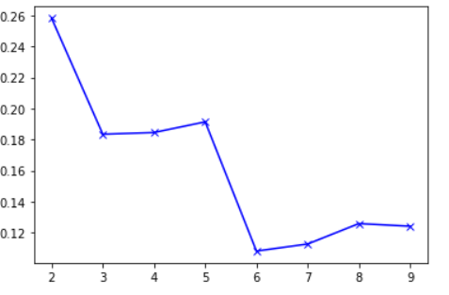
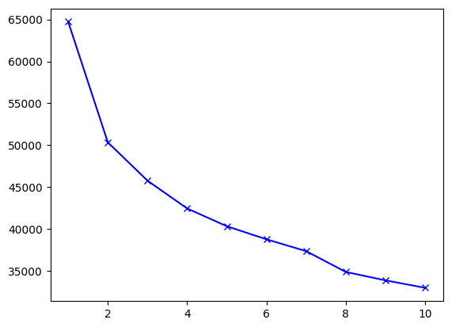
Silhouette score
Elbow method

Slide 14
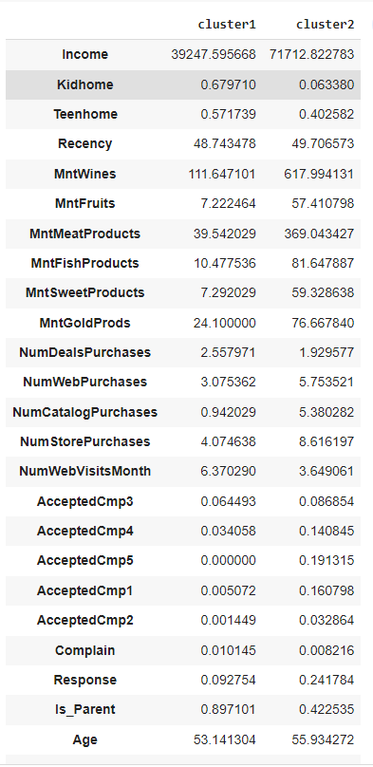
Cluster Profiling
This is the mean of each attribute after clustering and categorized into their respective clusters.
The graphical representation would help us to understand better.

Slide 15
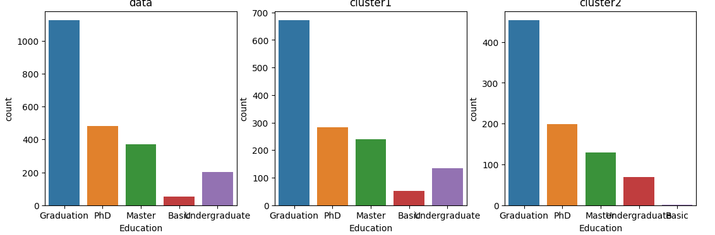
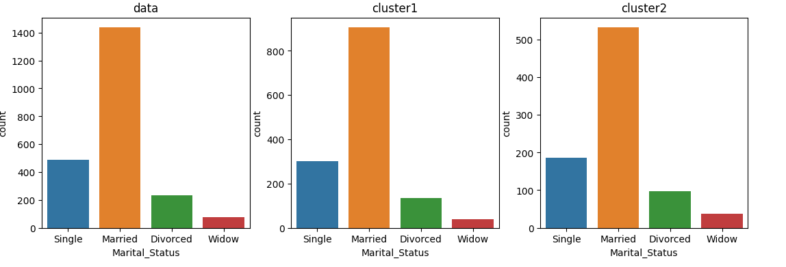

Slide 16
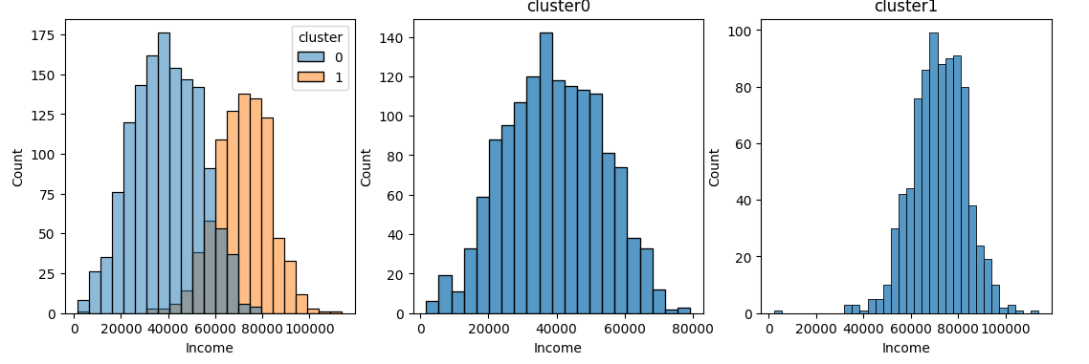
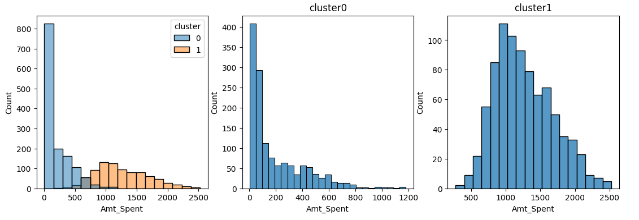

Slide 17
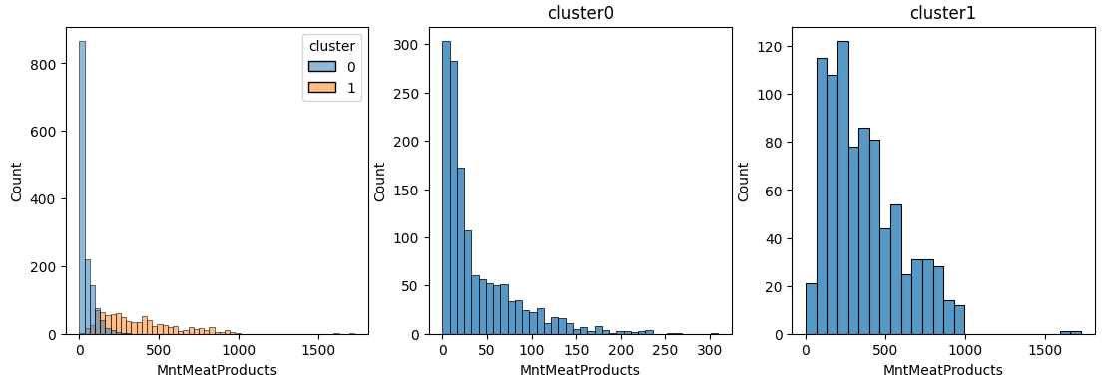
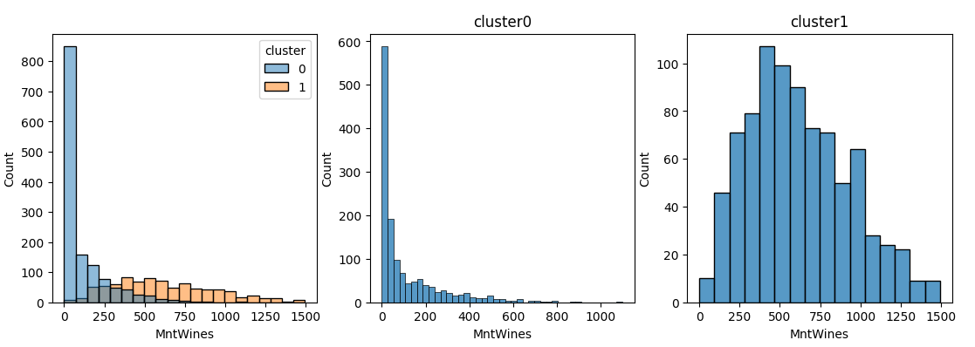

Slide 18
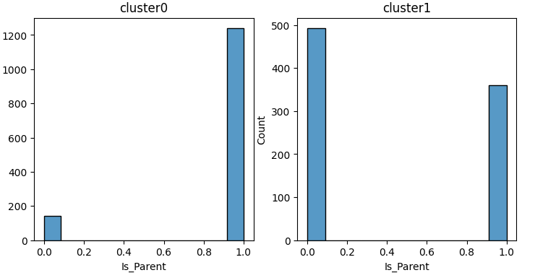
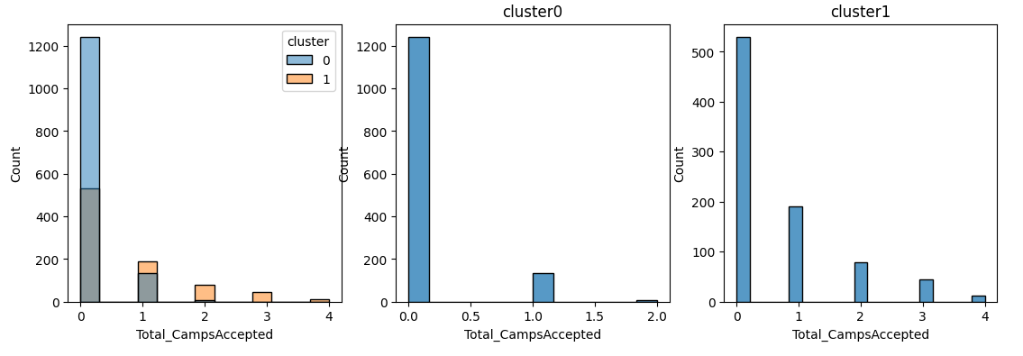

Slide 19
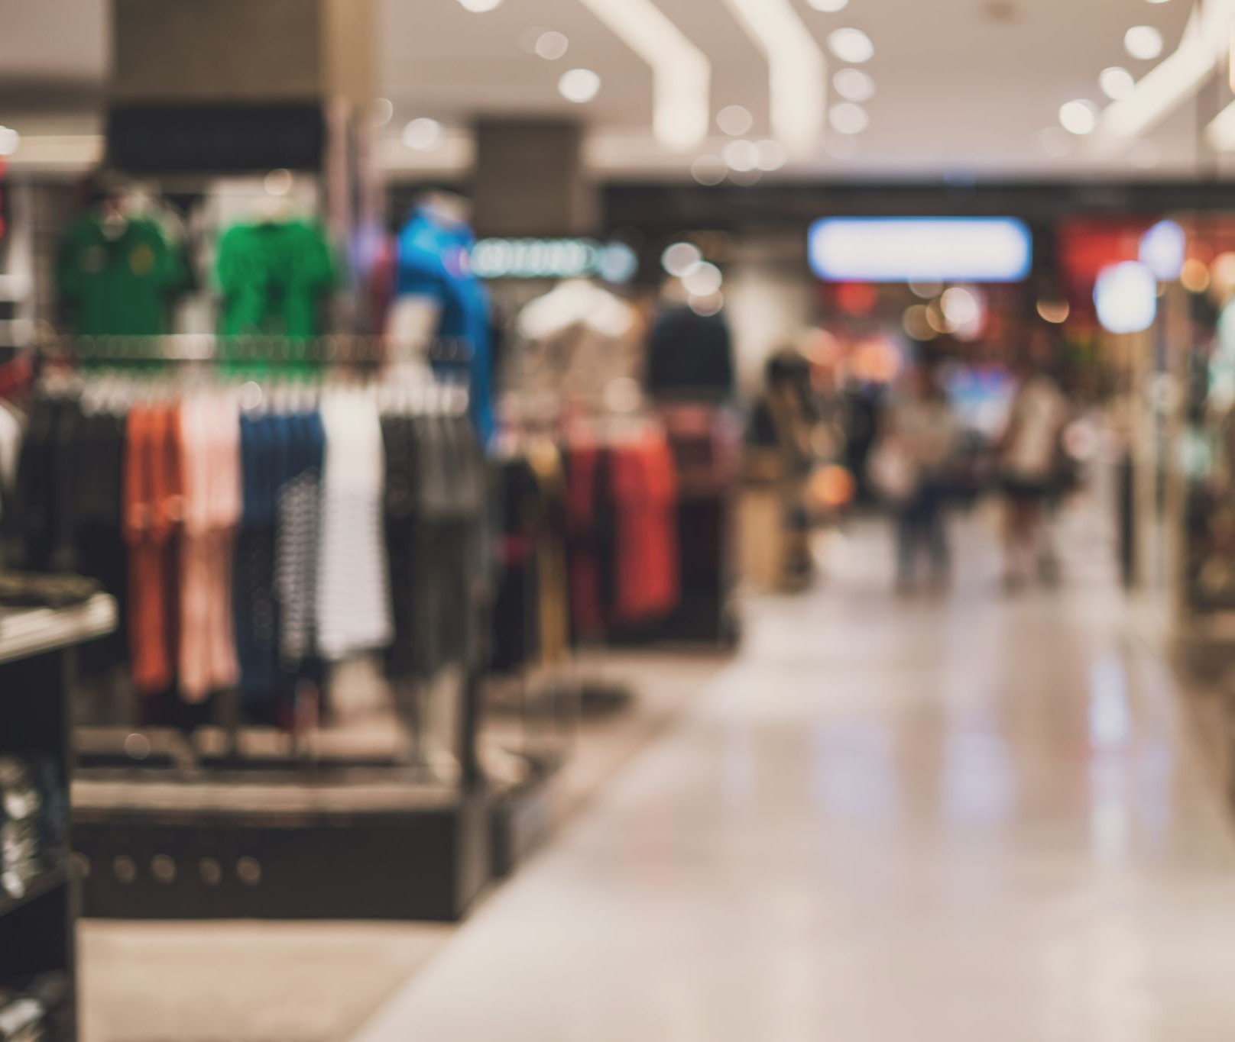
Conclusion
After performing the cluster profiling we get to know how they were grouped.
This will helps us to promote the products that the customers are going to buy and it will also help us save on promotion of products.

Slide 20

Thank You

